Slide 1
§10.2 Graph Terminology
You need to learn the following terms:
Adjacent, connects, endpoints, degree, initial, terminal, in-degree, out-degree, complete, cycles, wheels, n-cubes, bipartite, subgraph, union.
School of Computer Science, BUPT

Slide 2
Adjacency
Let G be an undirected graph with edge set E. Let e∈E be (or map to) the pair {u,v}. Then we say:
u, v are adjacent / neighbors / connected.
Edge e is incident with vertices u and v.
Edge e connects u and v.
Vertices u and v are endpoints of edge e.
School of Computer Science, BUPT

Slide 3
Neighborhood
The set of all neighbors of a vertex v of G = (V ,E), denoted by N(v), is called the neighborhood of v.
If A is a subset of V , we denote by N(A) the set of all vertices in G that are adjacent to at least one vertex in A. So,
School of Computer Science, BUPT

Slide 4
Degree of a Vertex
Let G be an undirected graph, v∈V a vertex.
The degree of v, deg(v), is its number of incident edges. (Except that any self-loops are counted twice.)
A vertex with degree 0 is called isolated.
A vertex of degree 1 is called pendant.
School of Computer Science, BUPT

Slide 5
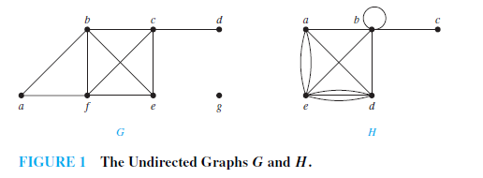
Example 1
School of Computer Science, BUPT

Slide 6
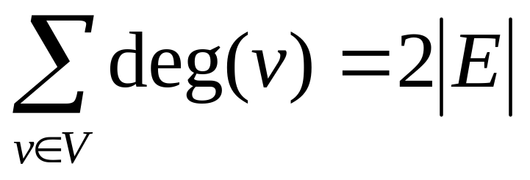
Handshaking Theorem
Let G be an undirected (simple, multi-, or pseudo-) graph with vertex set V and edge set E. Then
Corollary: Any undirected graph has an even number of vertices of odd degree.
School of Computer Science, BUPT

Slide 7
Directed Adjacency
Let G be a directed (possibly multi-) graph, and let e be an edge of G that is (or maps to) (u,v). Then we say:
  u is adjacent to v, v is adjacent from u
  e comes from u, e goes to v.
  e connects u to v, e goes from u to v
  the initial vertex of e is u
  the terminal vertex of e is v
School of Computer Science, BUPT

Slide 8
Directed Degree
Let G be a directed graph, v a vertex of G.
  The in-degree of v, deg⁻(v), is the number of edges going to v.
  The out-degree of v, deg⁺(v), is the number of edges coming from v.
  The degree of v, deg(v):≡deg⁻(v)+deg⁺(v), is the sum of v’s in-degree and out-degree.
School of Computer Science, BUPT

Slide 9
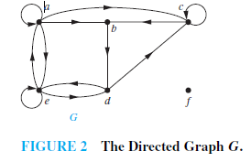
Example 4
School of Computer Science, BUPT

Slide 10
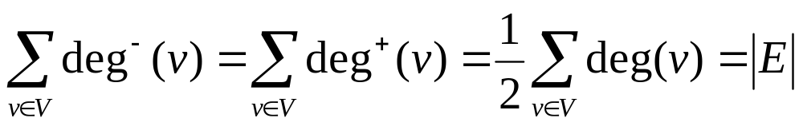
Directed Handshaking Theorem
Let G be a directed (possibly multi-) graph with vertex set V and edge set E. Then:
Note that the degree of a node is unchanged by whether we consider its edges to be directed or undirected.
School of Computer Science, BUPT

Slide 11
Underlying undirected graph
The undirected graph that results from ignoring directions of edges is called the underlying undirected graph.
School of Computer Science, BUPT

Slide 12
Special Graph Structures
Special cases of undirected graph structures:
Complete graphs K_{n}
Cycles C_{n}
Wheels W_{n}
n-Cubes Q_{n}
Bipartite graphs
Complete bipartite graphs K_{m,n}
School of Computer Science, BUPT

Slide 13
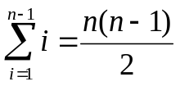
Complete Graphs
For any n∈N, a complete graph on n vertices, K_{n}, is a simple graph with n nodes in which every node is adjacent to every other node: ∀u,v∈V: u≠v↔{u,v}∈E.
K₁
K₂
K₃
K₄
K₅
K₆
Note that K_{n} has edges.
School of Computer Science, BUPT

Slide 14
Cycles
For any n≥3, a cycle on n vertices, C_{n}, is a simple graph where V={v₁,v₂,… ,v_{n}} and E={{v₁,v₂},{v₂,v₃},…,{v_{n−1},v_{n}},{v_{n},v₁}}.
C₃
C₄
C₅
C₆
C₈
C₇
How many edges are there in C_{n}?
School of Computer Science, BUPT

Slide 15
Wheels
For any n≥3, a wheel W_{n}, is a simple graph obtained by taking the cycle C_{n} and adding one extra vertex v_{hub} and n extra edges {{v_{hub},v₁}, {v_{hub},v₂},…,{v_{hub},v_{n}}}.
W₃
W₄
W₅
W₆
W₈
W₇
How many edges are there in W_{n}?
School of Computer Science, BUPT

Slide 16
n-cubes (hypercubes)
For any n∈N, the hypercube Q_{n} is a simple graph consisting of two copies of Q_{n-1} connected together at corresponding nodes. Q₀ has 1 node.
Q₀
Q₁
Q₂
Q₄
Q₃
Number of vertices: 2^{n}. Number of edges:Exercise to try!
School of Computer Science, BUPT

Slide 17
n-cubes (hypercubes)
For any n∈N, the hypercube Q_{n} can be defined recursively as follows:
  Q₀={{v₀},∅} (one node and no edges)
  For any n∈N, if Q_{n}=(V,E), where V={v₁,…,v_{a}} and E={e₁,…,e_{b}}, then Q_{n+1}=(V∪{v₁´,…,v_{a}´}, E∪{e₁´,…,e_{b}´}∪{{v₁,v₁´},{v₂,v₂´},…,
  {v_{a},v_{a}´}}) where v₁´,…,v_{a}´ are new vertices, and where if e_{i}={v_{j},v_{k}} then e_{i}´={v_{j}´,v_{k}´}.
School of Computer Science, BUPT

Slide 18
Bipartite Graphs
Def’n.: A graph G=(V,E) is bipartite (two-part) iff V = V₁ ∪ V₂ where V₁ ∩ V₂=∅ and
∀e∈E: ∃v₁∈V₁,v₂∈V₂: e={v₁,v₂}.
In English: The graph can
be divided into two parts
in such a way that all edges
go between the two parts.
V₁
V₂
This definition can easily be adapted for the
case of multigraphs and directed graphs as well.
Can represent with
zero-one matrices.
School of Computer Science, BUPT

Slide 19
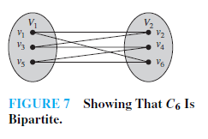
Example 9
School of Computer Science, BUPT

Slide 20
Example 10
K₃ is not bipartite.
School of Computer Science, BUPT

Slide 21
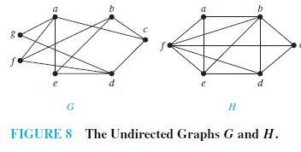
Example 11
Are the graphs G and H displayed in Figure 8 bipartite?
School of Computer Science, BUPT

Slide 22
Theorem
A simple graph is bipartite if and only if it is possible to assign one of two different colors to each vertex of the graph so that no two adjacent vertices are assigned the same color.
School of Computer Science, BUPT

Slide 23
Complete Bipartite Graphs
For m,n∈N, the complete bipartite graph K_{m,n} is a bipartite graph where |V₁| = m,
|V₂| = n, and E = {{v₁,v₂}|v₁∈V₁ ∧ v₂∈V₂}.
  That is, there are m nodes
  in the left part, n nodes in
  the right part, and every
  node in the left part is
  connected to every node
  in the right part.
K_{4,3}
K_{m,n} has _____ nodes
and _____ edges.
School of Computer Science, BUPT

Slide 24
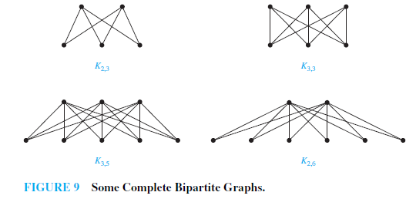
School of Computer Science, BUPT

Slide 25
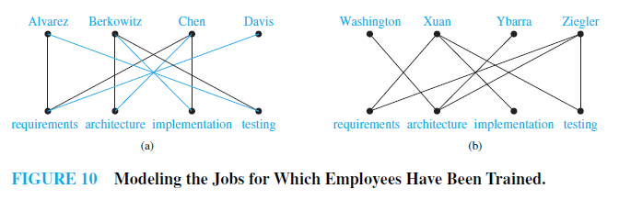
Bipartite Graphs and Matchings
Job Assignments
School of Computer Science, BUPT

Slide 26
A matching M in a simple graph G = (V ,E) is a subset of the set E of edges of the graph such that no two edges are incident with the same vertex.
A vertex that is the endpoint of an edge of a matching M is said to be matched in M; otherwise it is said to be unmatched.
A maximum matching is a matching with the largest number of edges.
A matching M in a bipartite graph G = (V ,E) with bipartition (V₁, V₂) is a complete matching from V₁ to V₂ if every vertex in V₁ is the endpoint of an edge in the matching, or equivalently, if |M| = |V₁|.
School of Computer Science, BUPT

Slide 27
HALL’S MARRIAGE THEOREM
The bipartite graph G = (V ,E) with bipartition (V₁, V₂) has a complete matching from V₁ to V₂ if and only if |N(A)| ≥ |A| for all subsets A of V₁.
School of Computer Science, BUPT

Slide 28
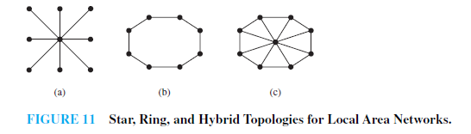
Local Area Networks
School of Computer Science, BUPT

Slide 29

Interconnection Networks for Parallel Computation
School of Computer Science, BUPT

Slide 30
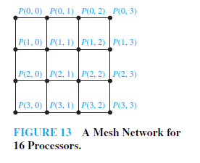
School of Computer Science, BUPT

Slide 31
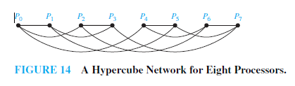
School of Computer Science, BUPT

Slide 32
Subgraphs
A subgraph of a graph G=(V,E) is a graph H=(W,F) where W⊆V and F⊆E.
A subgraph H of G is a proper subgraph of G if H ≠ G.
G
H
School of Computer Science, BUPT

Slide 33
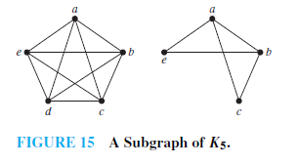
School of Computer Science, BUPT

Slide 34
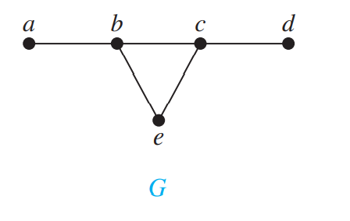
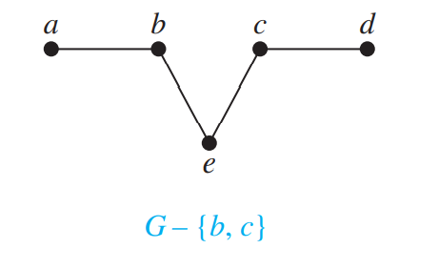
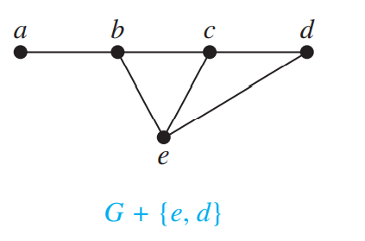
REMOVING OR ADDING EDGES OF A GRAPH
G − e = (V, E − {e})
G + e = (V, E ∪ {e})

Slide 35
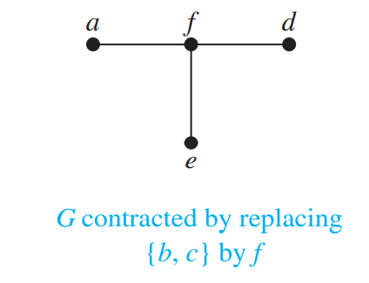
EDGE CONTRACTIONS

Slide 36
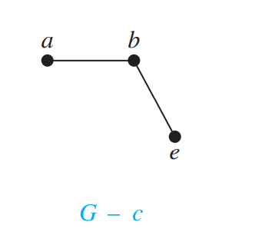
REMOVING VERTICES FROM A GRAPH

Slide 37
Graph Unions
The union G₁∪G₂ of two simple graphs G₁=(V₁, E₁) and G₂=(V₂,E₂) is the simple graph (V₁∪V₂, E₁∪E₂).
a
b
c
∪
a
b
c
d
e
d
f
School of Computer Science, BUPT

Slide 38
Homework
§10.2
  12, 44, 66, 74
School of Computer Science, BUPT

